Slide 1

CMR COLLEGE OF ENGINEERING & TECHNOLOGY
Kandlakoya, Medchal, Hyderabad - 501401
Department of Computer Science and Engineering
JoinChat
Name of the student & Roll.No.
G. Kiran Deepak (19H51A0570)
K. Sri Harsha (19H51A0573)
G. Pranay Kumar(19H51A05F8)
Under esteemed guidance of
Guide Name
Dr. A. Poongodai

Slide 2
Outline
Abstract
Introduction
Literature survey
Existed system
- Problems in existed system
Research Objective of Presentation
Problem Definition
Block Diagram
Proposed system
Results
Conclusion
Future Work
Notes:
2

Slide 3
Abstract
Notes:
3

Slide 4

ABSTRACT
Chat refers to the process of communicating, interacting or exchanging messages over the Internet. It involves two or more individuals that communicate through a chat-enabled service or software. Chat may be delivered through text, audio or video communication via the Internet. A chat application has basic two components, server and client. A server is a computer program or a device that provides functionality for other programs or devices. Clients who want to chat with each other connect to the server.The chat application we are going to make will be more like a chat room, rather than a peer to peer chat. So this means that multiple users can connect to the chat server and send their messages. Every message is broadcasted to every connected chat user.

Slide 5
INTRODUCTION
Notes:
5

Slide 6

Introduction
Online chat is a form of communication that utilizes computer programs that allow for two-way conversations between users in real time. Online chat may refer to any kind of communication over the Internet that offers a real- time transmission of text messages from sender to receiver.
Name of our project is JoinChat.The main purpose of this project is to build a online real time chatting web application which helps internet users who are online to communicate and share files. Existing Chat applications need a criteria like phone number or mail Id to login but in this there is no need of such data but rather the user is required to enter his user id and room id so, that all his/her friends can join in that room and communicate by messages and also they can share files in that room. This application is secure because the messages in the room are not saved in any database.
Once the users are in the same chat room, they can converse with one another by typing messages into a window where all of the other users in the chat room can see the message. The user can also see all of the messages entered by the other users. Conversations are then carried on by reading the messages entered by the other users in the chat room and responding to them. They can also send files and download them.
Notes:
6

Slide 7
Literature Survey
Notes:
7

Slide 8


Existed system
Facebook:
Facebook is an online social media and social networking service owned by American company Meta Platforms. Founded in 2004 by Mark Zuckerberg .
Facebook can be accessed from devices with Internet connectivity,
such as personal computers, tablets and smartphones. After registering,
users can create a profile revealing information about themselves. They
can post text, photos and multimedia which are shared with any other users
who have agreed to be their "friend" or with different privacy settings, publicly.
Users can also communicate directly with each other with Facebook Messenger.
Instagram:
Instagram is a photo and video sharing social networking service owned by American company Meta Platforms, it was launched in 2010 by Kevin Systrom. The app allows users to
upload media that can be edited with filters and organized by hashtags and
geographical tagging. Posts can be shared publicly or with pre approved
followers.
Notes:
8

Slide 9


WhatsApp:
It is owned by American company Meta Platforms (formerly Facebook). It allows users to send text and voice messages, make voice and video calls, and share images,
documents, user locations, and other content. WhatsApp's client
application runs on mobile devices, and can be accessed from
computers. The service requires a cellular mobile telephone
number to sign up.
User needs to send chat request before sending any messages to any user. When user accept their request then only they send the messages otherwise not. User has to login their application with their email id and password.

Slide 10
Research Objective
Notes:
10

Slide 11

Research objective
The main objective of this project is to allow each and every person can get connect with each other.
Providing a social platform to users.
Allows users to share files.
To allow each person to share their thoughts & views.
This System can be used as discussion board. Connecting people together.
Allowing the user to use anywhere anytime.

Slide 12
Problem Definition
Notes:
12

Slide 13
Problem Definition
This project is to create a chat application and enable the users to chat with each other on the web.
Until now to share any url or attachment from your mobile to our system or friend's system we had to login a social media account like whatsapp or google drive in both our mobile and system which is a bit time consuming and not always we get the need to share files to just our personal systems but to our friends and we don’t want to login our whatsapp in others device which is a hassle but not anymore with [joinchat] enables us to instantly create a room without any sign up and share texts,links,files to our friends or ourselves from our mobile to pc or pc to pc any way how we want....
This project is made up on the idea to create an instant ,messaging and file sharing solution to enable users to seamlessly communicate and share files without signing up and to do it from any device.
Join chat has been developed in order to overcome the difficulties encountered while using the mailing system for communication between the users. Providing user friendly communication channel, live communication facility, no need to sign up, the accessibility to access it from any device whether it is an android or ios or windows or mac or linux , to be able to send files and all of this with ensured privacy as nothing gets stored on the server.

Slide 14
Block Diagram
Notes:
14

Slide 15
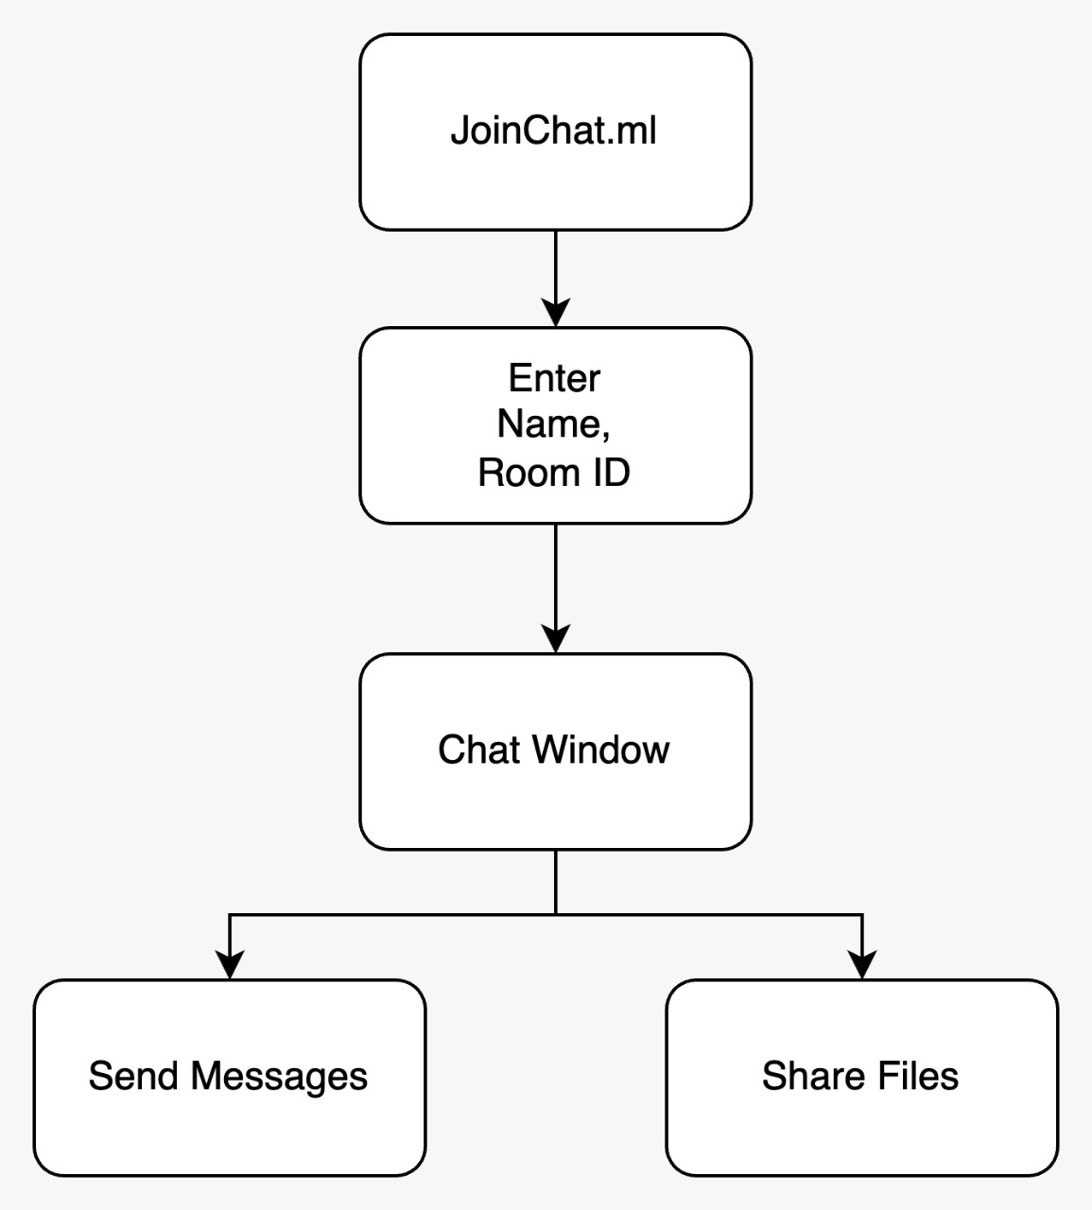
Block Diagram

Slide 16
Proposed system
Notes:
16

Slide 17
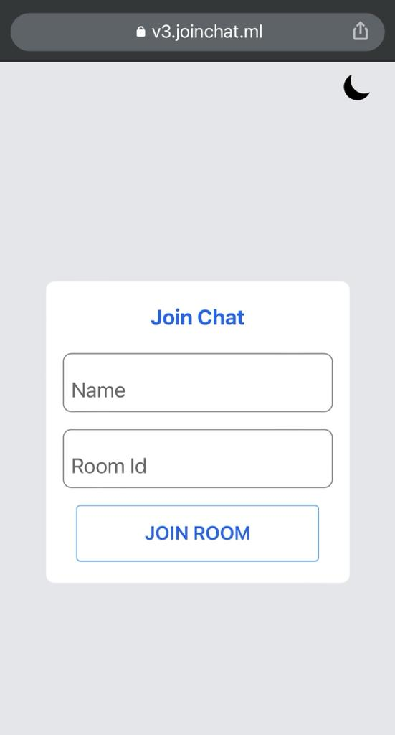
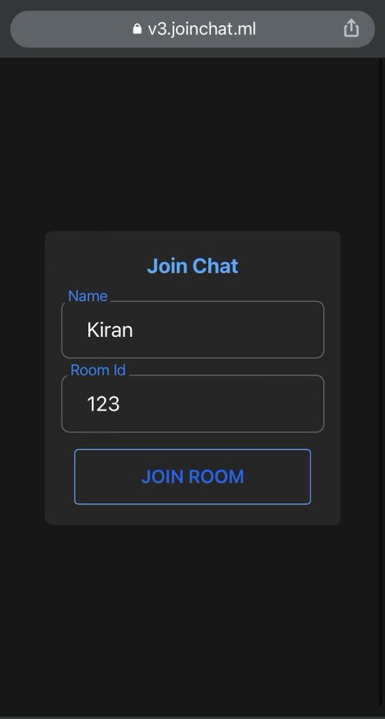
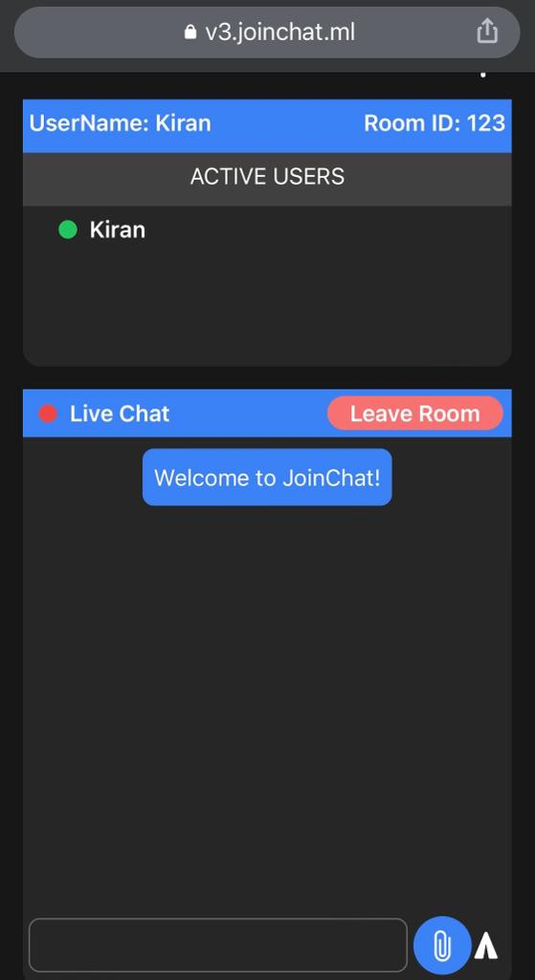
Proposed system

Slide 18
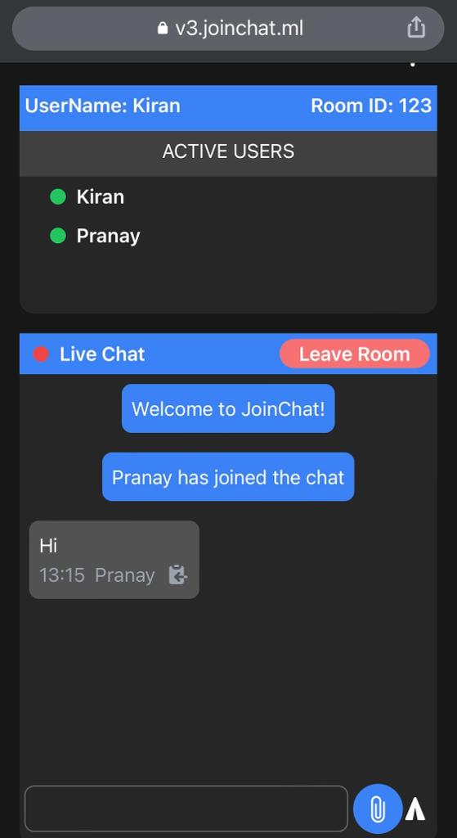
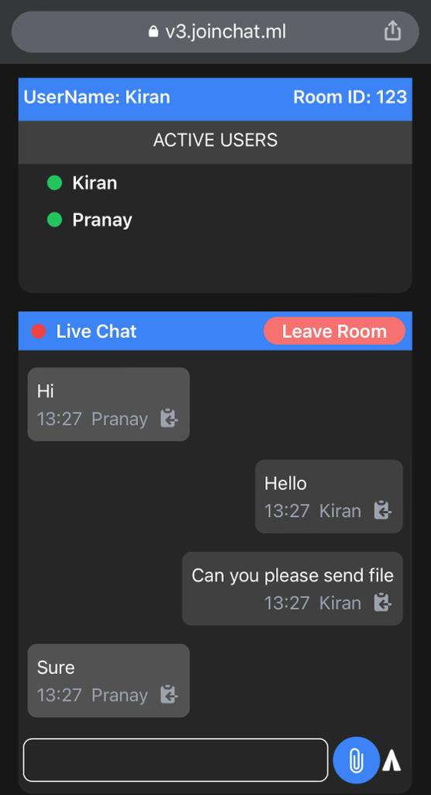
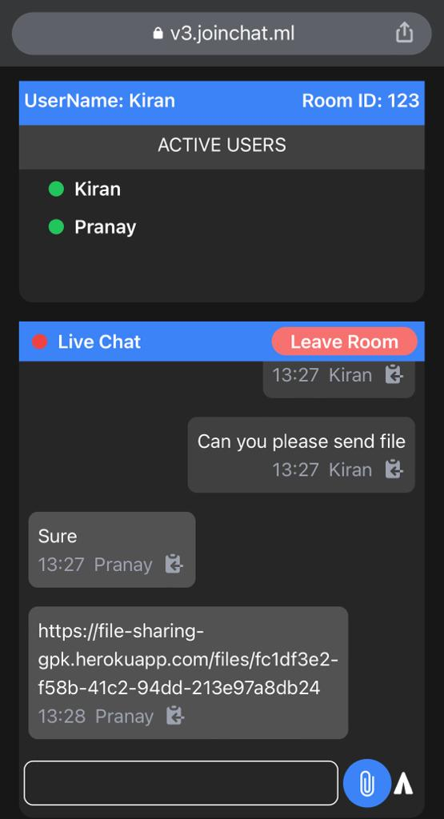

Slide 19
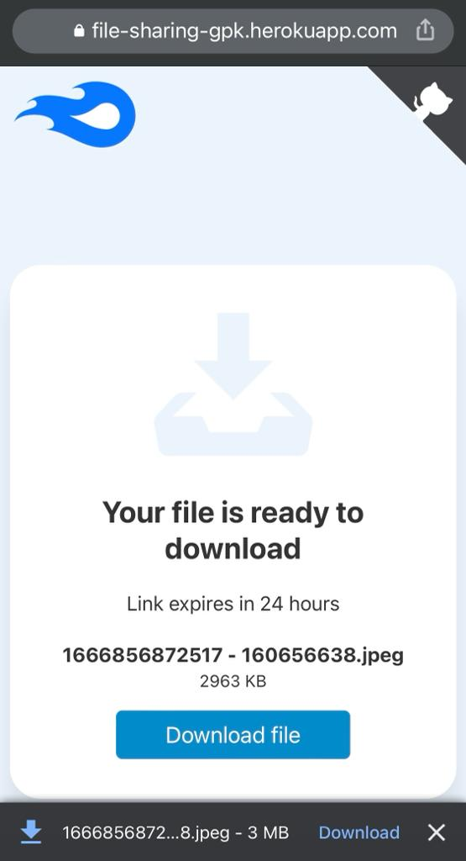
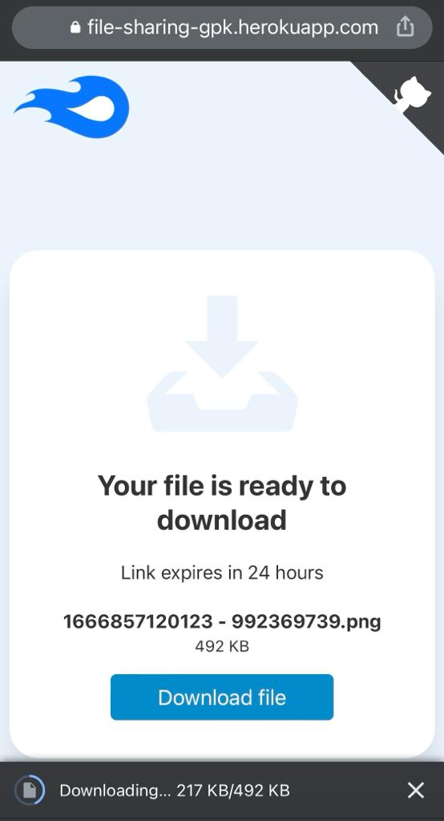
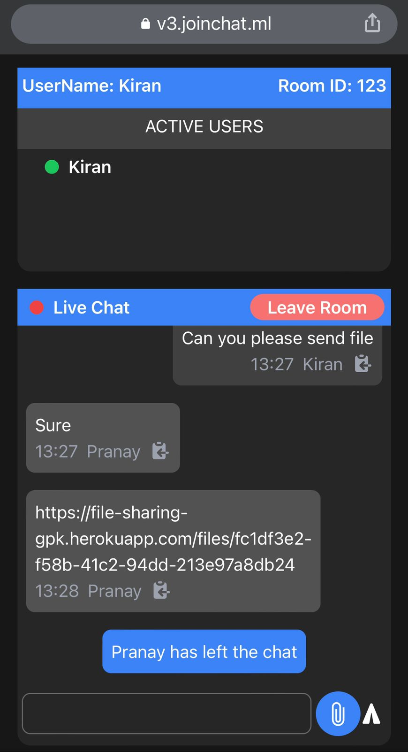

Slide 20
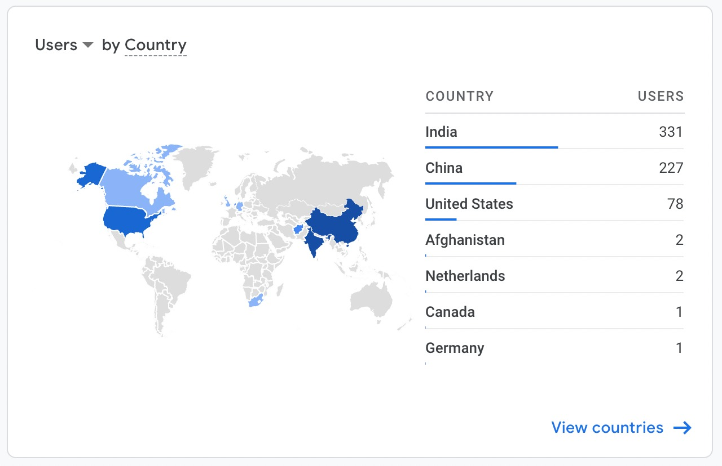
Result
Total 644 unique users

Slide 21
Conclusion
Our project solves the problem to always login into different social media apps and sites to communicate and share files over different devices with different people but by this all in one web based chat application where there is no need to sign in and anyone can use it to chat with people and share files from any device to any device.
Nothing is stored on the server ,that means all the messages, files, users logs nothing gets recorded and the chat system is encrypted.
It is fast, reliable and saves time.
This project interface is simple and any person will be able to use it at first glance.

Slide 22

Future work
There is always a room for improvements in any apps. Right now, we are just dealing with text communication in public rooms with the feature to send any type of attachments . There are several chat apps which serve similar purpose as this project, but these apps were rather difficult to use and need to create an account in it and add all our details in it and provide confusing interfaces. In future we may be extended to include features such as:
Private rooms with key
Voice Message
Video Message
Audio Call
Video Call
Group Call

Slide 23
References
https://socket.io/docs/v4/
https://tailwindcss.com/docs/installation
https://www.npmjs.com/package/multer
https://www.investopedia.com/articles/investing/102615/story-instagram-rise-1-photo0sharing-app.asp
https://www.docsity.com/en/online-chatting-system/4614473/
https://www.slideshare.net/adkpcte/report-on-online-chatting
http://indusedu.org/pdfs/IJREISS/IJREISS_3661_55346.pdf

Slide 24
Thank You!

